Slide 1
Network Programming with Java

Slide 2
Clients and Servers
Computer network is a set of computers connected together for the purpose of sharing resources
The most common categories of network software nowadays are clients and servers.
A server, as the name implies, provides a service of some kind.
This service is provided for clients that connect to the server's host machine specifically for the purpose of accessing the service.
clients that initiate a dialogue with the server

Slide 3
Computer Ports
Port is an endpoint of communication and is identified by a number in the range 1-65535.
Transmission Control Protocol (TCP) and the User Datagram Protocol (UDP), encode port numbers in the packet header.
Ports are implemented upon all computers attached to a network.
Each port may be dedicated to a particular server/service.

Slide 4
Port numbers in the range 1-1023 are normally set aside for the use of specified standard services, often referred to as 'well-known' services.
When a client attempts to make connection with a particular server program, it supplies the port number of the associated service.

Slide 5
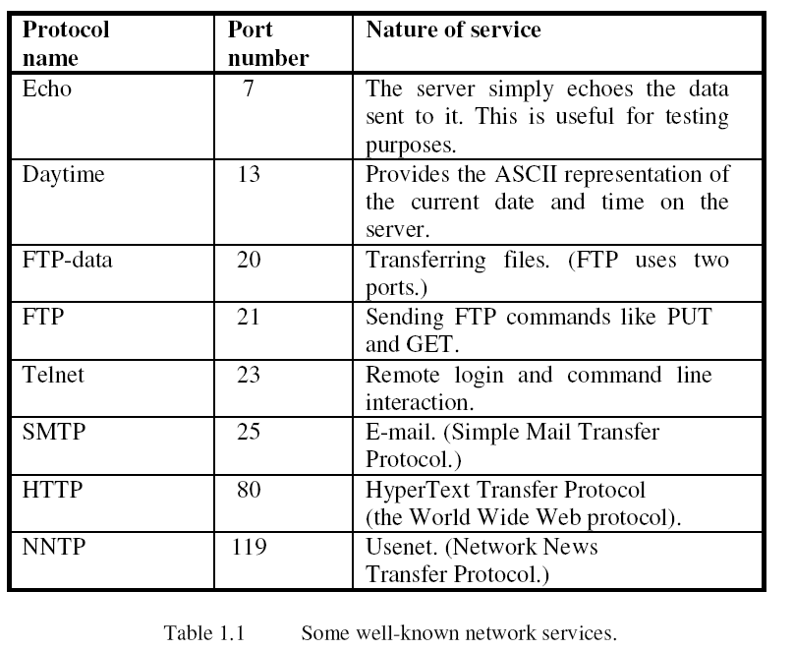

Slide 6
Sockets
socket is an abstract concept and not an element of computer hardware.
It is communication link between two processes.
A common example of this requirement is that of multiple browsers (quite possibly thousands of them) wanting Web pages from the same server.
Distinguishing between clients and keeping their dialogues separate from each other. This is achieved via the use of sockets

Slide 7
The Internet and IP Addresses
An internet (lower-case 'i') is a collection of computer networks.
The protocol used for such communication is called the Internet Protocol (IP).
Each computer on the Internet has a unique IP address, the current version of which is IPv6 (Internet Protocol version 6).
For example, 131.122.3.219 would be one such address.

Slide 8
TCP/IP
Internet is a packet-switched network, which means that messages between computers on the Internet are broken up into blocks of information called packets.
IP and TCP are the two commonest protocols used on the Internet and are almost invariably coupled together as TCP/IP.
TCP (Transmission Control Protocol), which allowed each end of a connection to acknowledge receipt of IP packets and/or requires retransmission of lost or corrupted packets

Slide 9
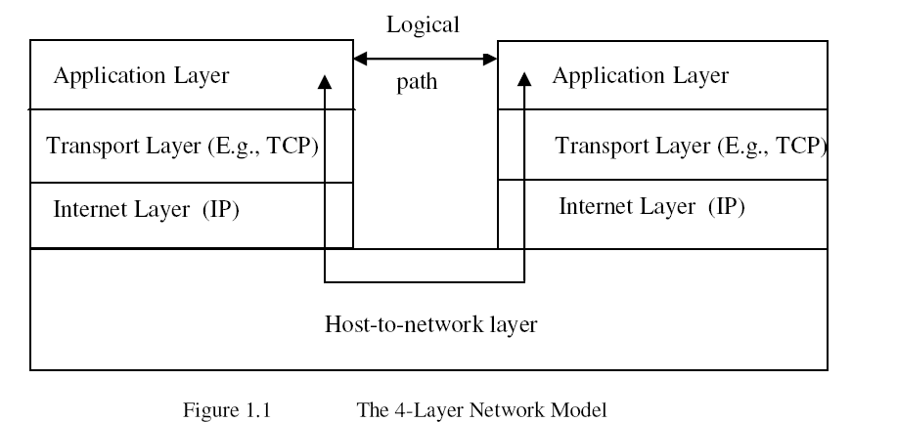
(segments)
(Packets)

Slide 10
UDP
User Datagram Protocol (UDP) is faster than TCP.
UDP is an unreliable protocol, since:
it doesn't guarantee that each packet will arrive;
it doesn't guarantee that packets will be in the right order.
UDP doesn't re-send a packet if it is missing or there is some other error, and it doesn't assemble packets into the correct order

Slide 11
Starting Network Programming in Java

Slide 12
The InetAddress Class
One of the classes within package java.net is called InetAddress, which handles Internet addresses both as host names and as IP addresses.
Method getByName of this class uses DNS to return the Internet address of a specified host name as an InetAddress object.
getByName throws the checked exception UnknownHostException if the host name is not recognised

Slide 13
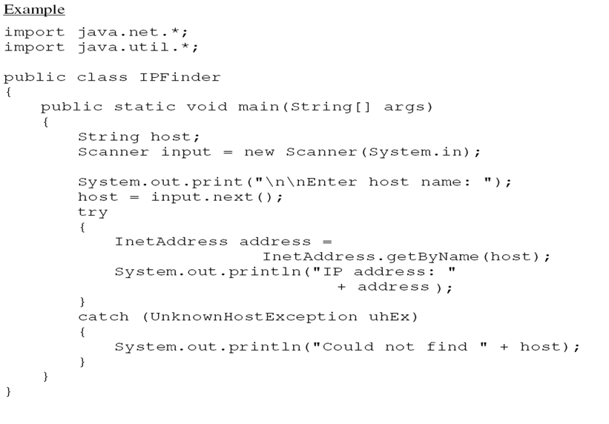

Slide 14
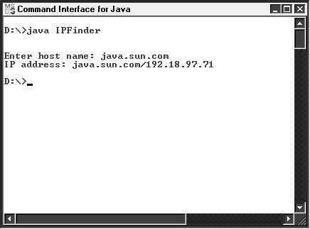

Slide 15
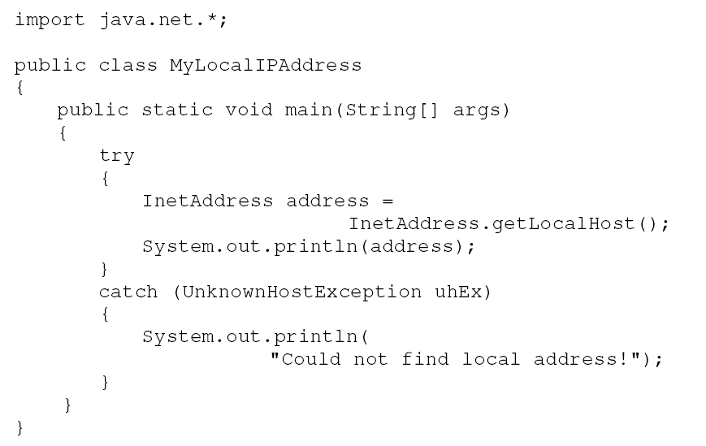
IP address of the current machine

Slide 16
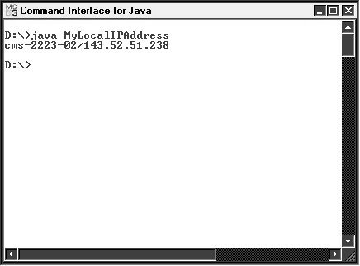

Slide 17
TCP Sockets
A communication link created via TCP/IP sockets is a connection-orientated link.
Connection between server and client remains open throughout only broken formally terminates the exchanges.
There are two separate types of process involved :client and server

Slide 18
Create a socket program using TCP sockets to send message between client and server.

Slide 19
Basic Steps for the Server End
1.Create a Server Socket object.
2. Put the server into a waiting state.
3. Set up input and output streams.
4. Send and receive data.
5. Close the connection (after completion of the dialogue).

Slide 20
Setting up a server process requires five steps...
Create a ServerSocket object.
ServerSocket servSock = new ServerSocket(1234);
2. Put the server into a waiting state.
Socket object when a connection is made.
Socket link = servSock.accept();
3. Set up input and output streams.
Scanner input = new Scanner(link.getInputStream());
PrintWriter output =new PrintWriter(link.getOutputStream(),true);
4. Send and receive data.
Use method nextLine for receiving data and method println for sending data,
output.println("Awaiting data...");
String input = input.nextLine();
5. Close the connection (after completion of the dialogue).
This is achieved via method close of class Socket. For example: link.close();

Slide 21
//Server that echoes back client's messages.
//messages received. Uses TCP.
import java.io.*;
import java.net.*;
import java.util.*;
public class TCPEchoServer
{
private static ServerSocket servSock;
private static final int PORT = 1234;
public static void main(String[] args)
{
System.out.println("Opening port...\n");
try
{
servSock = new ServerSocket(PORT); //Step 1.
}
catch(IOException ioEx)
{
System.out.println("Unable to attach to port!");
System.exit(1);
}
do
{
handleClient();
}while (true);
}

Slide 22
private static void handleClient()
{
Socket link = null; //Step 2.
try
{
link = servSock.accept(); //Step 2.
Scanner input =new Scanner(link.getInputStream());//Step 3.
PrintWriter output =new PrintWriter(link.getOutputStream(),true); //Step 3.
int numMessages = 0;
String message = input.nextLine(); //Step 4.
while (!message.equals("***CLOSE***"))
{
System.out.println("Message received.");
numMessages++;
output.println("Message " + numMessages+ ": " + message); //Step 4.
message = input.nextLine();
}
output.println(numMessages+ " messages received.");//Step 4.
}
catch(IOException ioEx)
{
ioEx.printStackTrace();
}

Slide 23
finally
{
try
{
System.out.println("\n* Closing connection... *");
link.close(); //Step 5.
}
catch(IOException ioEx)
{
System.out.println("Unable to disconnect!");
System.exit(1);
}
}
}
}

Slide 24
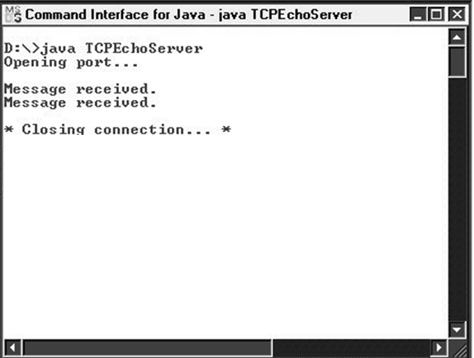

Slide 25
Basic Steps for the Client End:
1.Establish a connection to the server.
2. Set up input and output streams.
3. Send and receive data.
4. Close the connection.

Slide 26
Establish a connection to the server.
Socket link =new Socket(InetAddress.getLocalHost(),1234);
2. Set up input and output streams.
These are set up in exactly the same way as the server streams were set up
3. Send and receive data.
The Scanner object at the client end will receive messages sent by the PrintWriter object at the server end.
The PrintWriter object at the client end will send messages that are received by the Scanner object at the server end
4. Close the connection.
This is exactly the same as for the server process (using method close of class Socket).

Slide 27
import java.io.*;
import java.net.*;
import java.util.*;
public class TCPEchoClient
{
private static InetAddress host;
private static final int PORT = 1234;
public static void main(String[] args)
{
try
{
host = InetAddress.getLocalHost();
}
catch(UnknownHostException uhEx)
{
System.out.println("Host ID not found!");
System.exit(1);
}
accessServer();
}

Slide 28
private static void accessServer()
{
Socket link = null; //Step 1.
try
{
link = new Socket(host,PORT); //Step 1.
Scanner input =new Scanner(link.getInputStream()); //Step 2.
PrintWriter output =new PrintWriter(link.getOutputStream(),true); //Step 2.
//Set up stream for keyboard entry...
Scanner userEntry = new Scanner(System.in);
String message, response;
do
{
System.out.print("Enter message: ");
message = userEntry.nextLine();
output.println(message); //Step 3.
response = input.nextLine(); //Step 3.
System.out.println("\nSERVER> "+response);
}while (!message.equals("***CLOSE***"));
}
catch(IOException ioEx)
{
ioEx.printStackTrace();
}

Slide 29
finally
{
try
{
System.out.println("\n* Closing connection... *");
link.close(); //Step 4.
}
catch(IOException ioEx)
{
System.out.println("Unable to disconnect!");
System.exit(1);
}
}
}
}

Slide 30
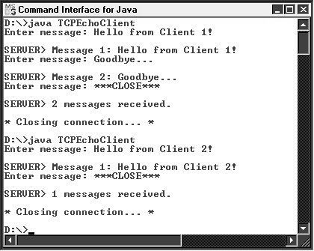

Slide 31
Datagram (UDP) Sockets
Unlike TCP/IP sockets, connection between client and server is not maintained throughout the duration of the dialogue.
Each datagram packet is sent as an isolated transmission whenever necessary.
Datagram Packet objects are created and sent at both ends, rather than simple strings.

Slide 32
Create a socket program using UDP sockets to send message between client and server.

Slide 33
Steps for the server end:
1.Create a DatagramSocket object.
2. Create a buffer for incoming datagrams.
3. Create a DatagramPacket object for the incoming datagrams.
4. Accept an incoming datagram.
5. Accept the sender's address and port from the packet.
6. Retrieve the data from the buffer.
7. Create the response datagram.
8. Send the response datagram.
9. Close the DatagramSocket.

Slide 34
Server END
1. Create a DatagramSocket object.
DatagramSocket datagramSocket = new DatagramSocket(1234);
2. Create a buffer for incoming datagrams.
This is achieved by creating an array of bytes. For example:
byte[] buffer = new byte[256];
3. Create a DatagramPacket object for the incoming datagrams.
The constructor for this object requires two arguments:
DatagramPacket inPacket =new DatagramPacket(buffer, buffer.length);
4. Accept an incoming datagram.
datagramSocket.receive(inPacket);
5. Accept the sender's address and port from the packet.
InetAddress clientAddress = inPacket.getAddress();
int clientPort = inPacket.getPort();

Slide 35
6. Retrieve the data from the buffer.
String message = new String(inPacket.getData(),0,inPacket.getLength());
7. Create the response datagram.
DatagramPacket outPacket = new DatagramPacket(response.getBytes(),
response.length(),clientAddress, clientPort);
8. Send the response datagram.
datagramSocket.send(outPacket);
Steps 4-8 may be executed indefinitely (within a loop).
9. Close the DatagramSocket.
datagramSocket.close();

Slide 36
Steps for the Client End.
1.Create a DatagramSocket object.
2. Create the outgoing datagram.
3. Send the datagram message.
4. Create a buffer for incoming datagrams.
5. Create a DatagramPacket object for the incoming datagrams.
6. Accept an incoming datagram.
7. Retrieve the data from the buffer.
8. Close the DatagramSocket.

Slide 37
Cliend End
Create a DatagramSocket object.
DatagramSocket datagramSocket = new DatagramSocket();
2. Create the outgoing datagram.
This step is exactly as for step 7 of the server program. For example:
DatagramPacket outPacket = new DatagramPacket(message.getBytes(),
message.length(), host, PORT);
3. Send the datagram message.
Just as for the server, this is achieved by calling method send of the DatagramSocket object, supplying our outgoing DatagramPacket object as an argument.
For example:
datagramSocket.send(outPacket);

Slide 38
Steps 4-6 below are exactly the same as steps 2-4 of the server procedure.
4. Create a buffer for incoming datagrams.
byte[] buffer = new byte[256];
5. Create a DatagramPacket object for the incoming datagrams.
DatagramPacket inPacket =new DatagramPacket(buffer, buffer.length);
6. Accept an incoming datagram.
datagramSocket.receive(inPacket);
7. Retrieve the data from the buffer.
This is the same as step 6 in the server program.
String response =new String(inPacket.getData(),0,inPacket.getLength());

Slide 39
Steps 2-7 may then be repeated as many times as required.
8. Close the DatagramSocket.
This is the same as step 9 in the server program.
datagramSocket.close();

Slide 40
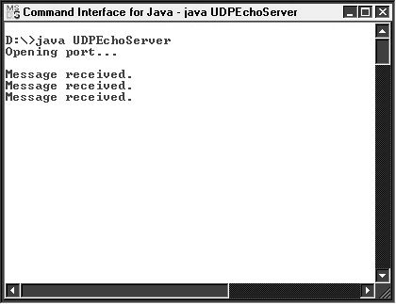

Slide 41
